Slide 1
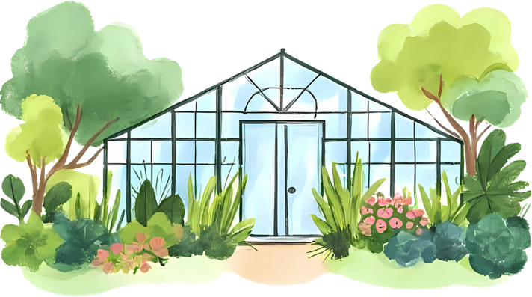




Courtyard Garden Project

Slide 2

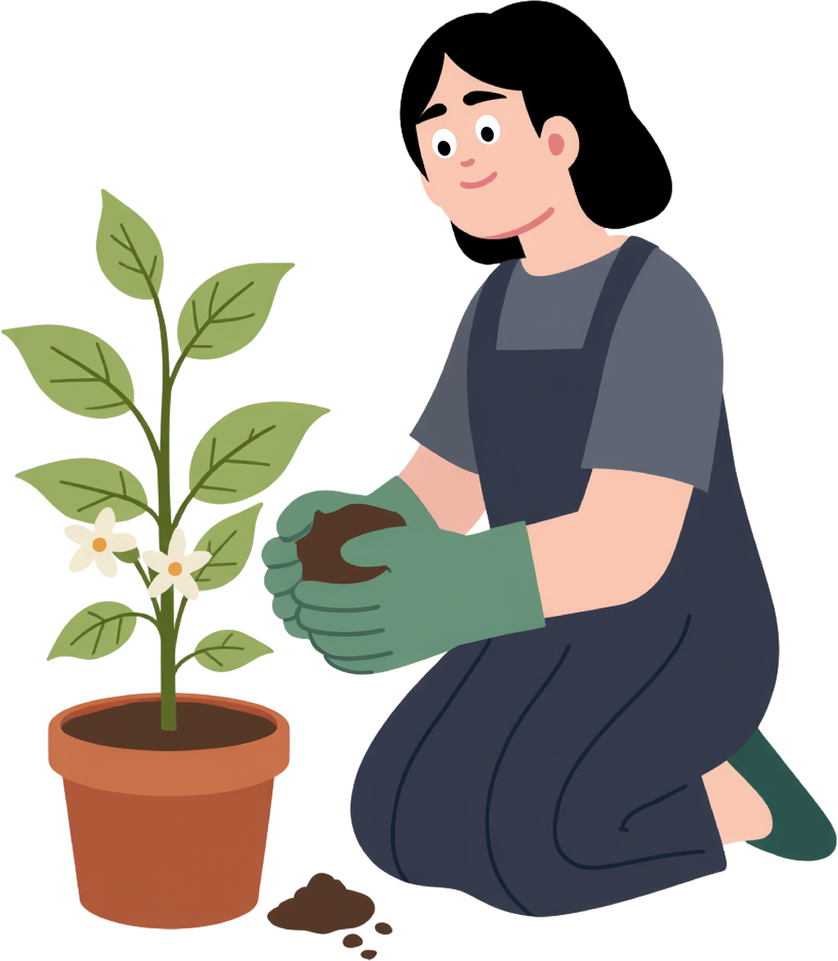
Project Aim
  Designed to stimulate senses
  Supporting wellbeing, engagement + regulation (Soga et al., 2017)
  Promote engagement and communication/interaction
  Incorporate messy play into learning environment
  Create a safe space for students - reducing stress (Hussein, 2010)
  Encourages movement and motor skills
  Provides accessible hands on learning
  Promotes meaningful engagement and inclusive participation (AOTA, 2020)
Notes:
Project aim
The aim of this courtyard garden proposal is to provide the college with a SEN-friendly sensory garden, designed to gently stimulate the senses while supporting wellbeing, engagement, and emotional regulation. It will provide a safe, calming space that reduces stress and encourages communication, interaction, and meaningful engagement. Through accessible, hands-on learning opportunities and messy play, the garden will promote movement, motor skill development, and inclusive participation for all students.

Slide 3
Background research
  Develop sensory processing skills by interacting with sounds, sights, textures, etc
  Nature based environments reduce anxiety, support emotional regulation and create calming spaces (Soga et al., 2017)
  Linked to reduction in depression, stress and emotional distress
  outdoor learning in sensory rich environments has shown higher engagement compared to indoor, improving focus and attention (Goldenberg et al., 2024)
  promotes movement, exploration, problem solving and motor skills
  develop turn taking, team working, and communication skills
  develop transferable skills that support them within college, community and adult life (Ozer, 2007)
  used therapeutically for individuals with differing needs
  offer controlled sensory stimuli
  encourages sensory regulation

Slide 4
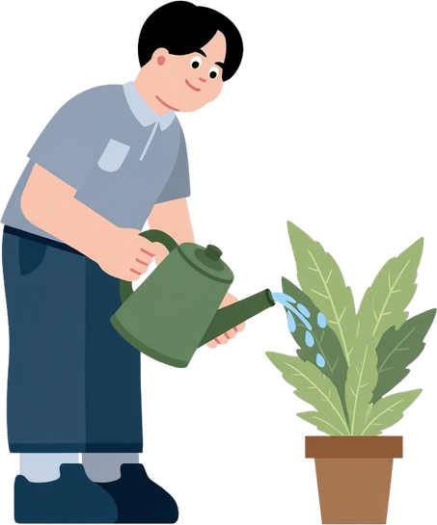
Importance for OT
  Aligns with OT principles, directly supporting occupational performance, engagement and participation
  Emotional regulation is fundamental to participation in meaningful occupations
  Facilitates embedding motor skills goals into functional activities within garden
  promotes accessibility
  RCOT - Occupation and holistic centered practice (RCOT, 2021)
  RCOT highlights environment as central to occupational functioning (RCOT, 2021)
  Promotes accessibility and removes barriers
  RCOT highlights importance of client centered, evidence based interventions (RCOT, 2021)
  Goals are functional and tailored to individual needs/interests
Notes:
This sensory garden strongly aligns with occupational therapy principles as it directly supports occupational performance, engagement, and participation. Emotional regulation is fundamental to enabling individuals to take part in meaningful occupations, and the garden provides a therapeutic environment that supports this regulation. Motor skill goals can be naturally embedded into functional, purposeful activities within the space, making interventions meaningful. In line with RCOT guidance the project reflects occupation-centred and holistic practice, recognising the environment as central to occupational functioning. By intentionally designing an accessible space that removes barriers and promotes engagement, the garden supports inclusion. It also reflects the importance of client-centred, evidence-based interventions that are functional and tailored to individual needs and interests, ensuring therapy is both meaningful and impactful.

Slide 5
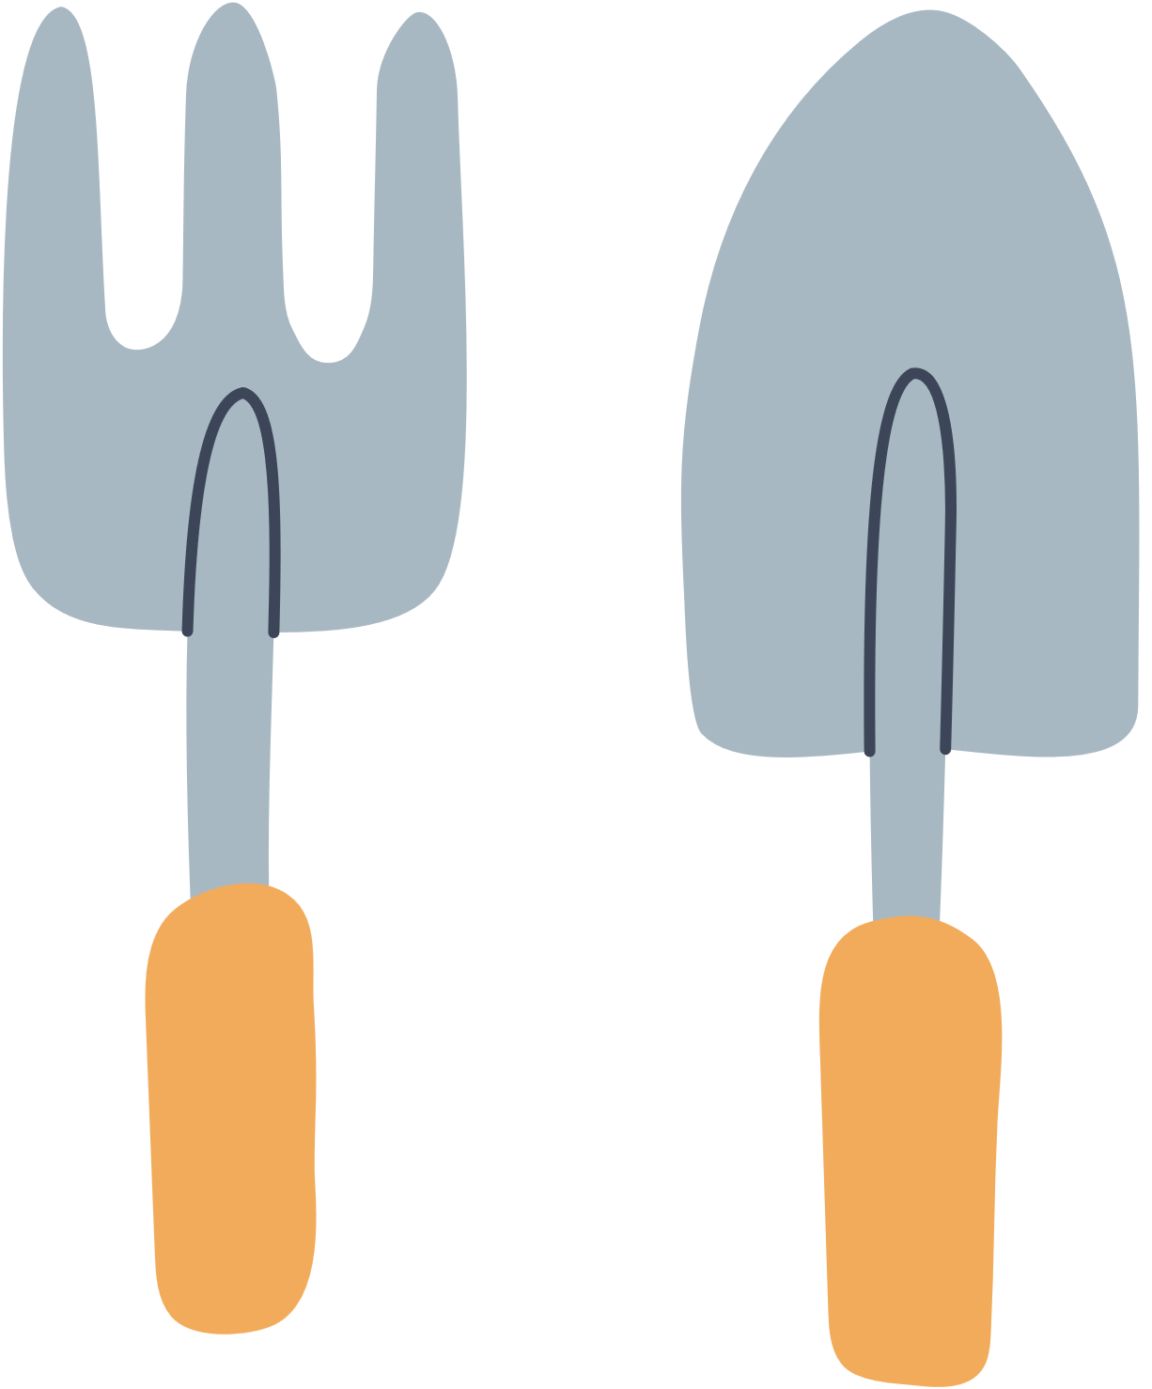
Complying with standards
  HCPC - undertake risk assessment
  HCPC - use sound clinical reasoning
  Ensure environment is safe/accessible and designed to prevent harm
  HCPC emphasises adapting environments, enabling participation and respecting individual need
  Equality Act 2010 - reasonable adjustments, reduce barriers
  Care Act 2014 - emphasises wellbeing and participation
  Legislation reinforces importance of designing inclusive spaces
  Promote engagement whilst safeguarding individuals
Notes:
This project also aligns with professional and legal standards that underpin occupational therapy practice. HCPC requires practitioners to undertake appropriate risk assessments, use sound clinical reasoning, and ensure environments are safe, accessible, and designed to prevent harm. The sensory garden reflects this by being intentionally adapted to enable participation while respecting individual needs and differences. It also aligns with key UK legislation, including the Equality Act 2010, which requires reasonable adjustments to reduce barriers for disabled individuals; the Health and Safety at Work Act 1974, which promotes safe environments; and the Care Act 2014, which emphasises wellbeing and participation. Together, these frameworks reinforce the importance of designing inclusive, enabling spaces that promote engagement while safeguarding those who use them.

Slide 6
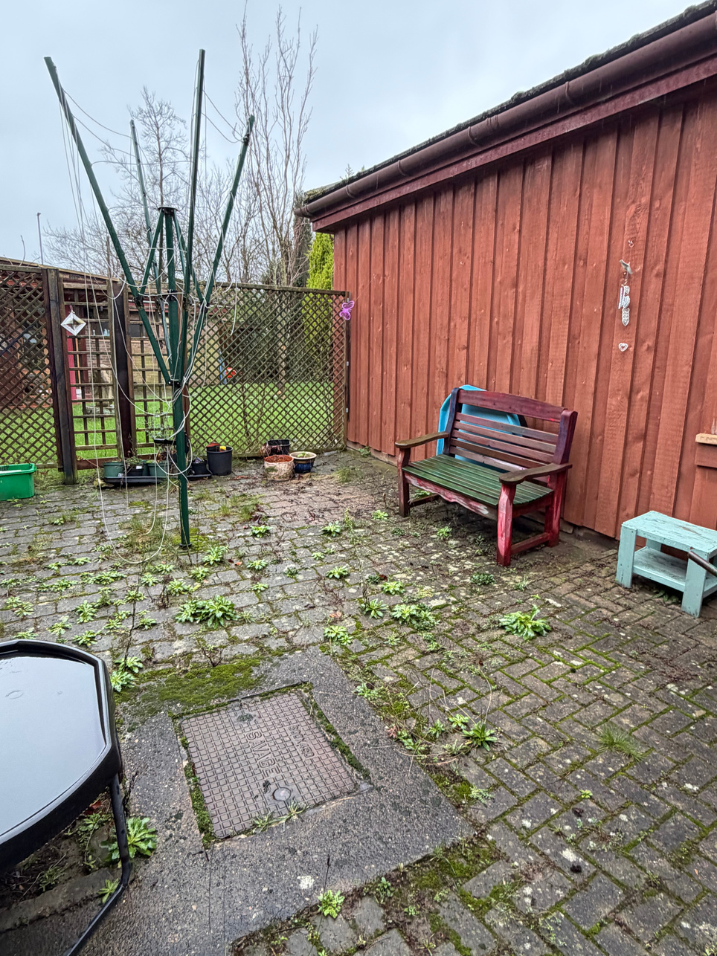
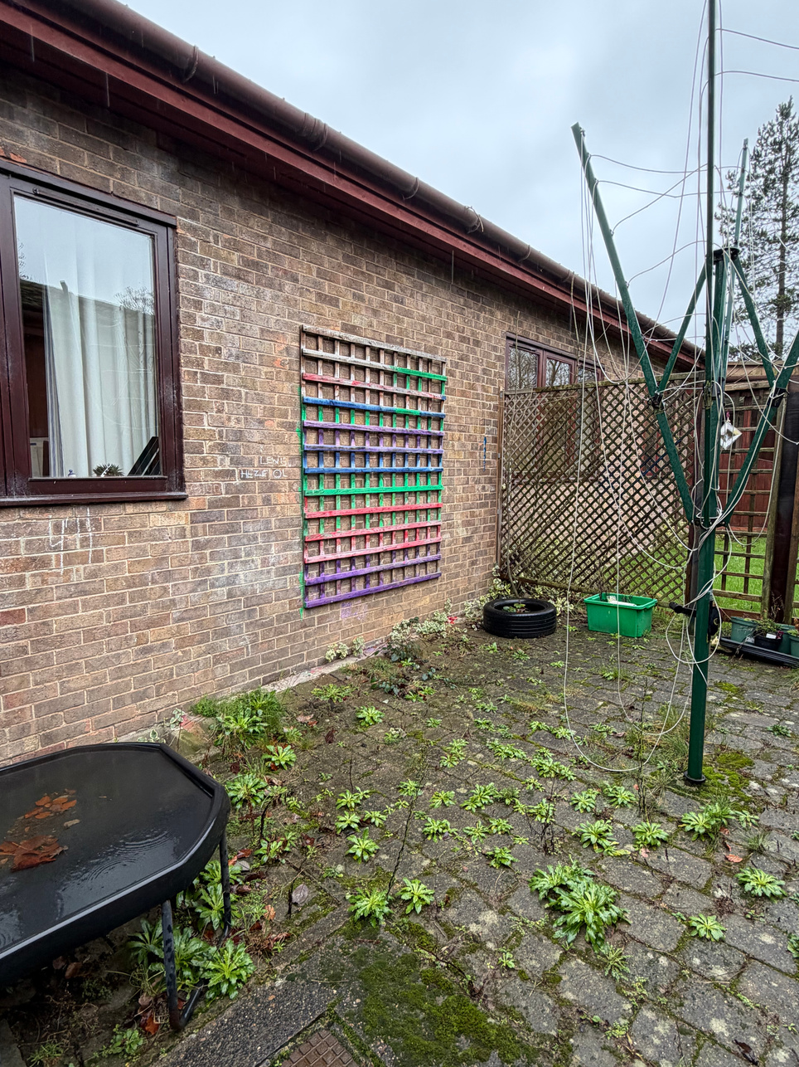
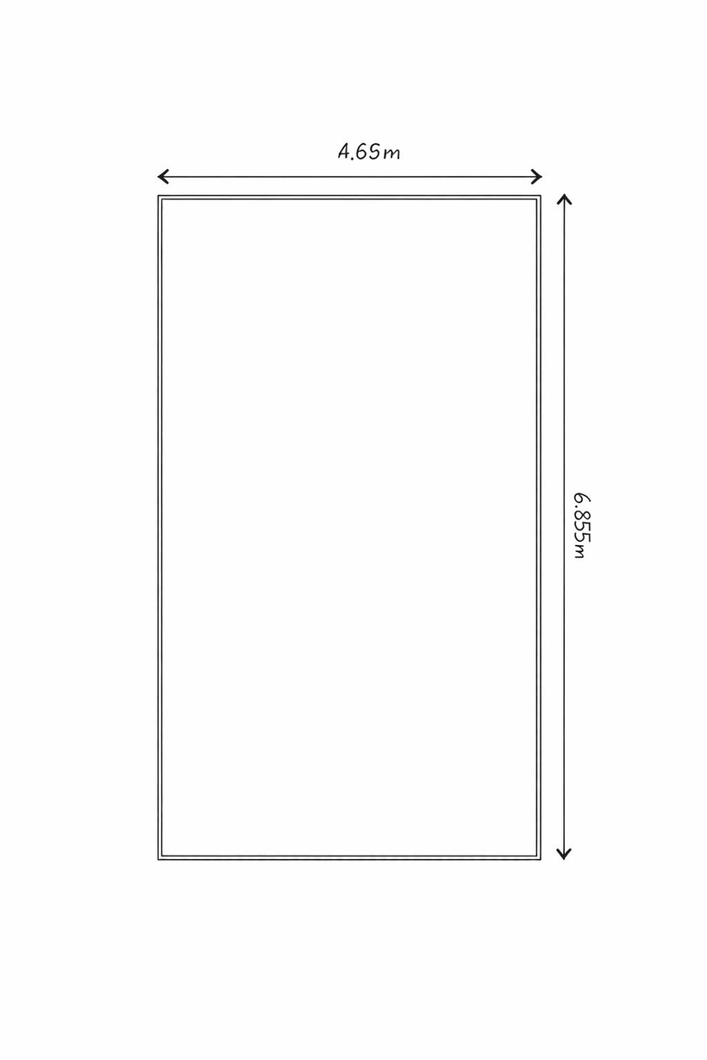
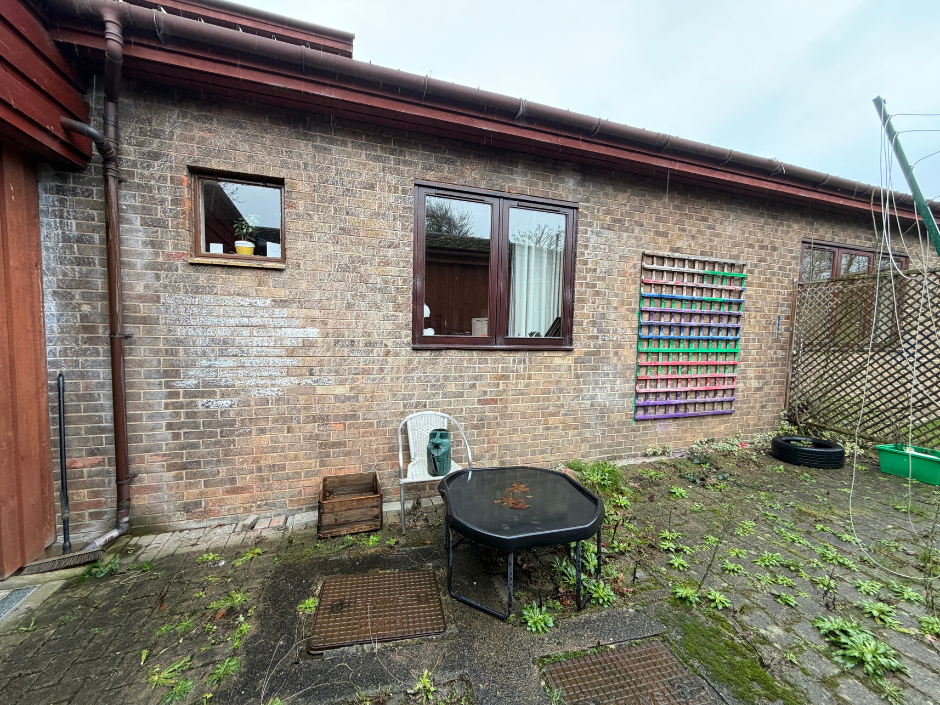
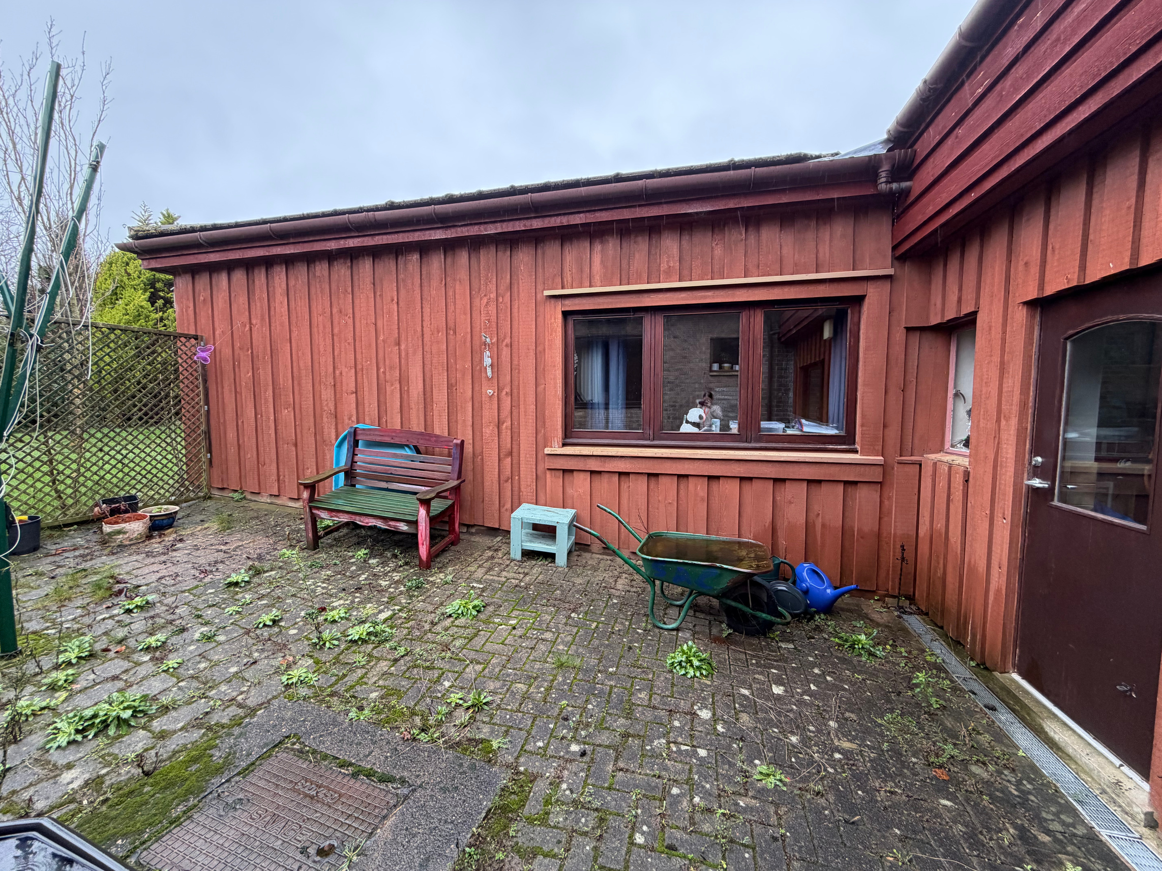
The space
Notes:
The current outdoor space is largely inaccessible and underutilised, with limited sensory features, minimal structure, and barriers that restrict safe and meaningful participation. At present, it does not effectively support emotional regulation, engagement, or motor development for students with additional needs

Slide 7
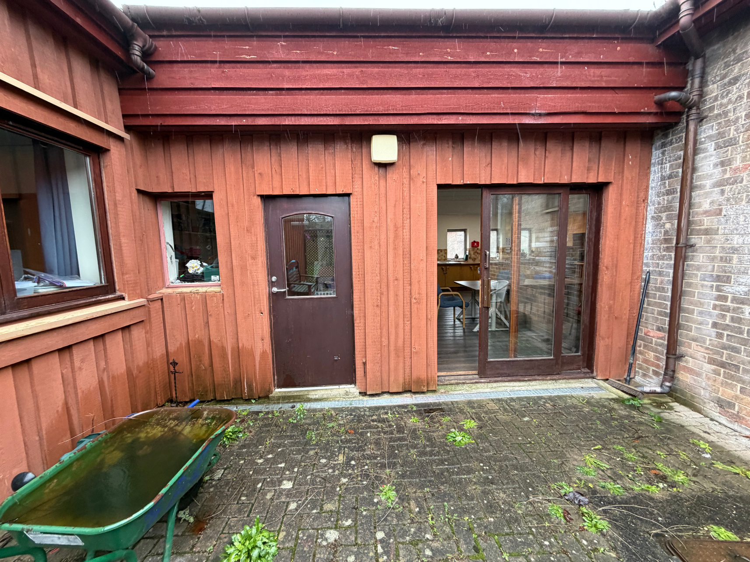
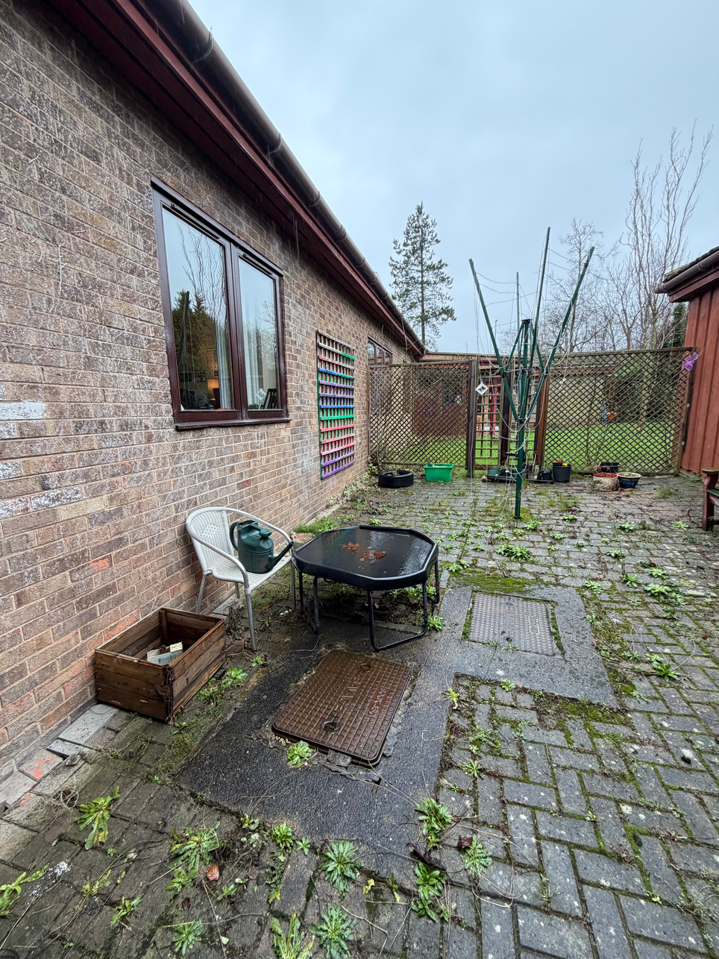
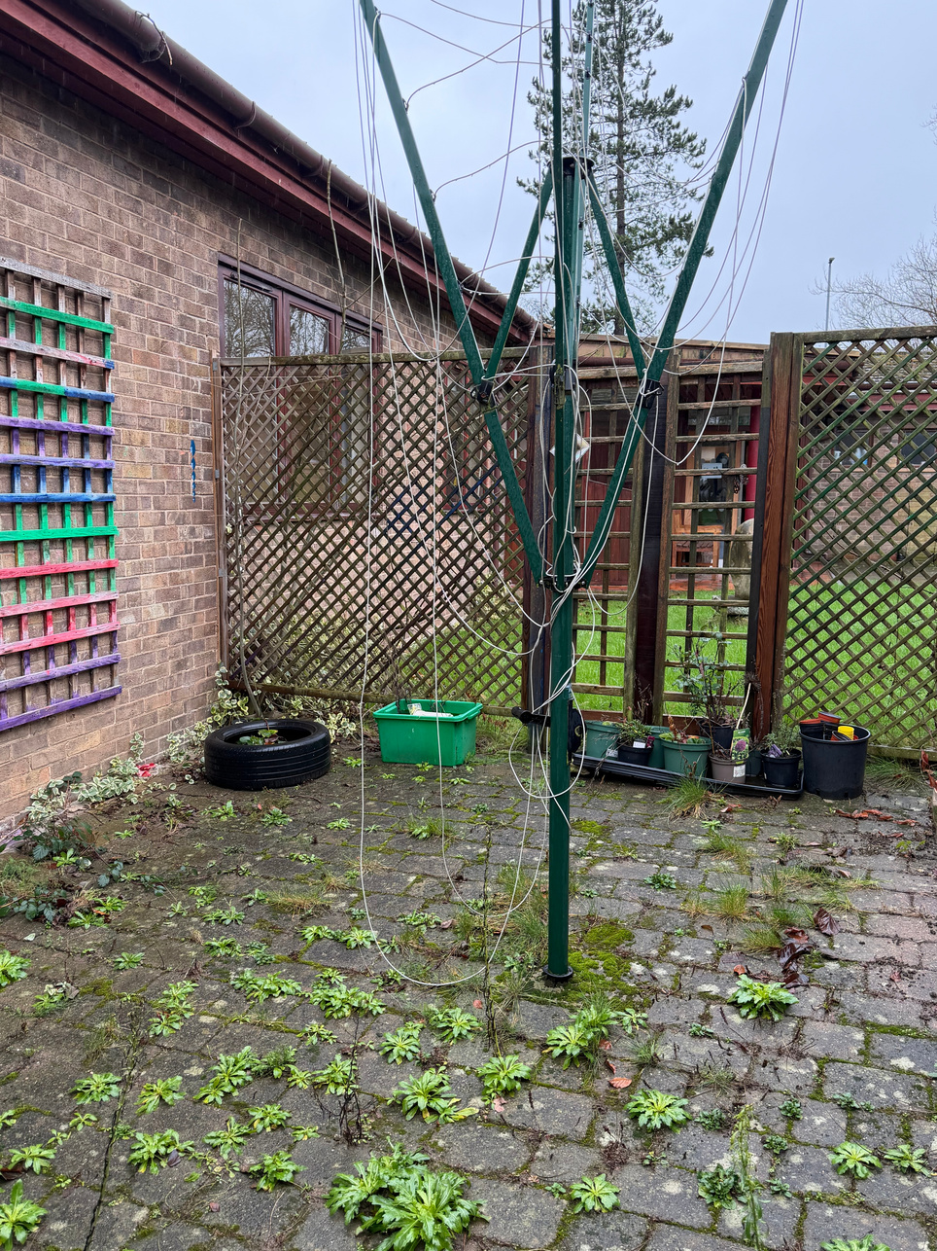
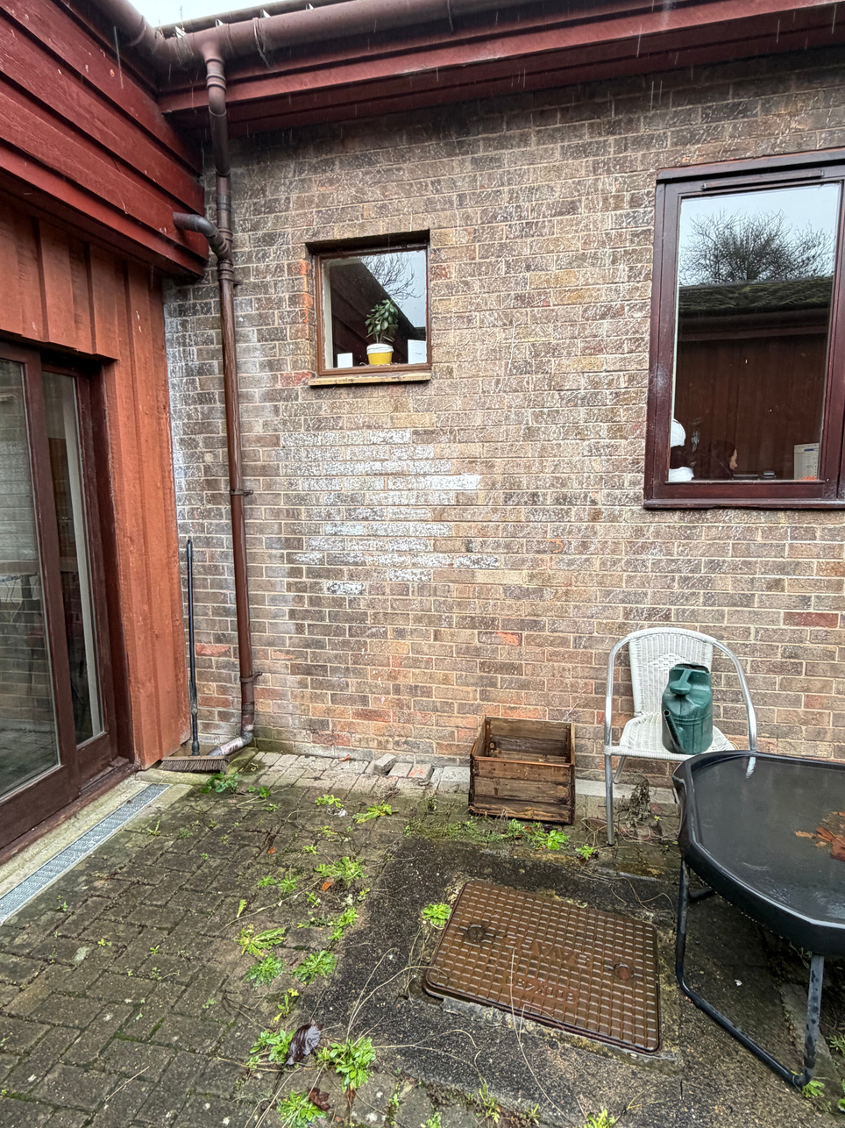
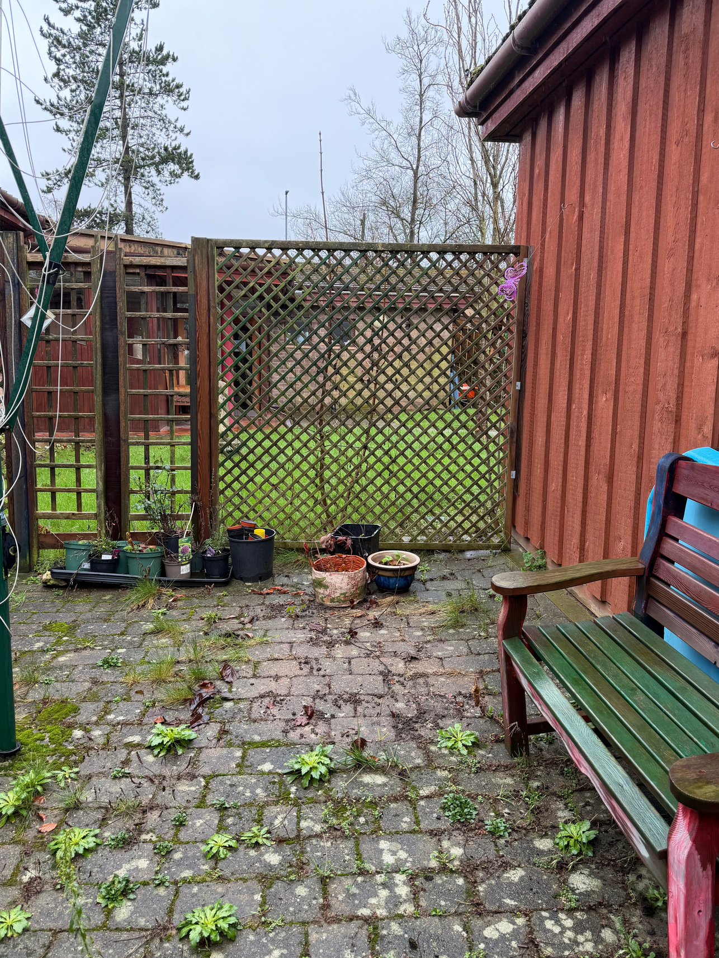
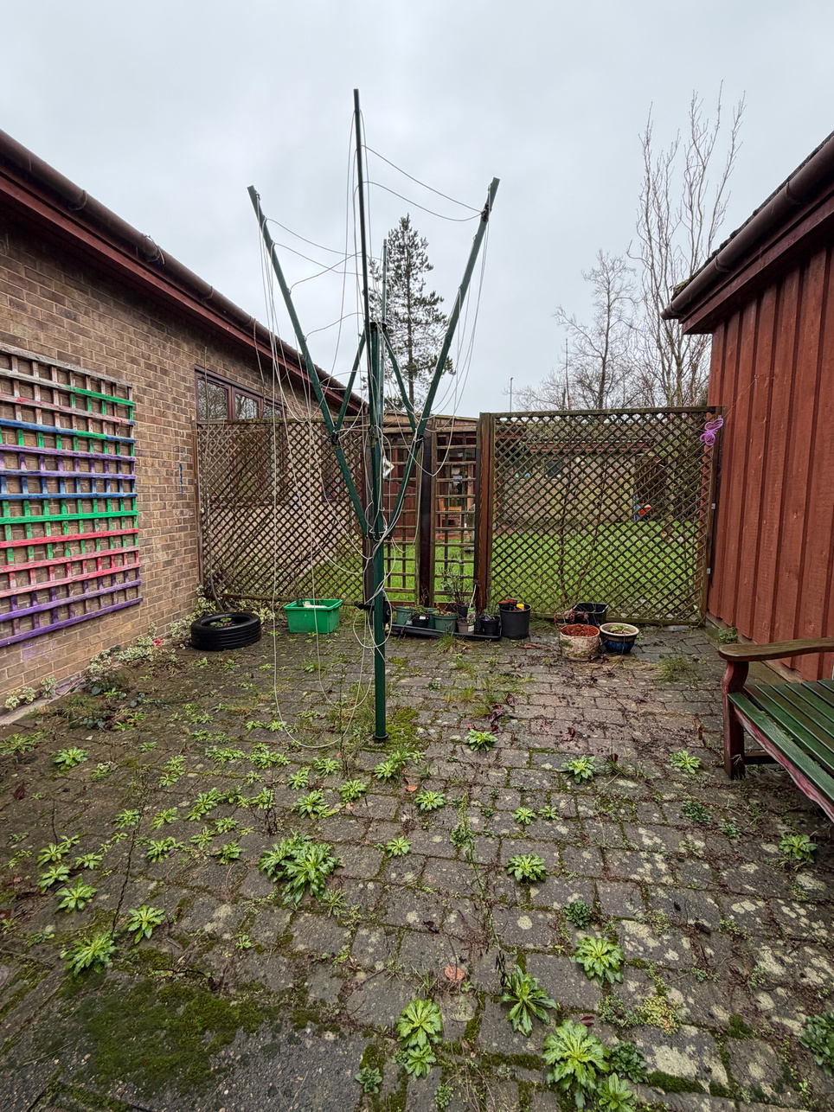
The space
Notes:
With thoughtful adaptation and inclusive design, it can be transformed into a safe, accessible sensory garden that promotes wellbeing, participation, and purposeful occupation.

Slide 8
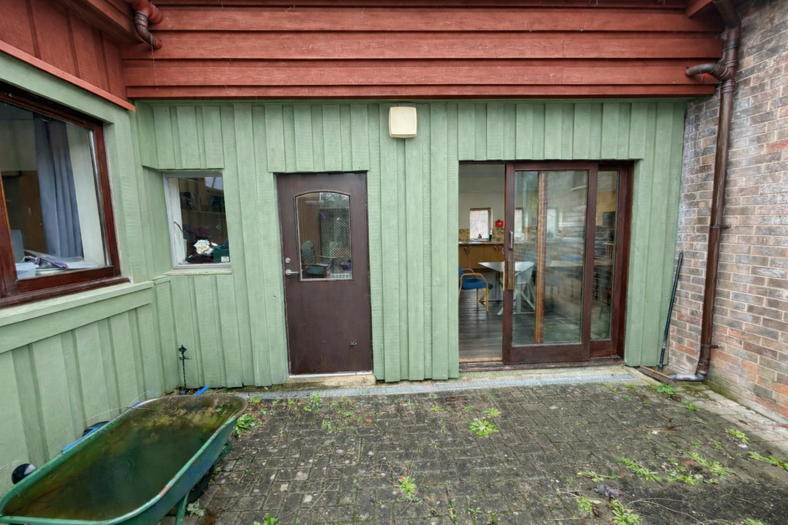
Adapting the current space
  Neutral colour - creates calmer, more regulated environment
  Reduces visual overwhelm
  Neutral tones support SEN by lowering sensory load
  Involving students in this process promotes ownership, engagement and meaningful participation
Notes:
Repainting the wooden wall in a soft, natural green helps create a calmer and more regulating environment, reducing visual overwhelm and making the space feel safe and grounded. Neutral, nature-based tones are particularly supportive in SEN settings as they lower sensory load while still feeling warm and inviting. Involving the children in the painting process also promotes ownership, engagement, and meaningful participation, supporting fine and gross motor skills, teamwork, and a sense of pride in shaping their environment.

Slide 9
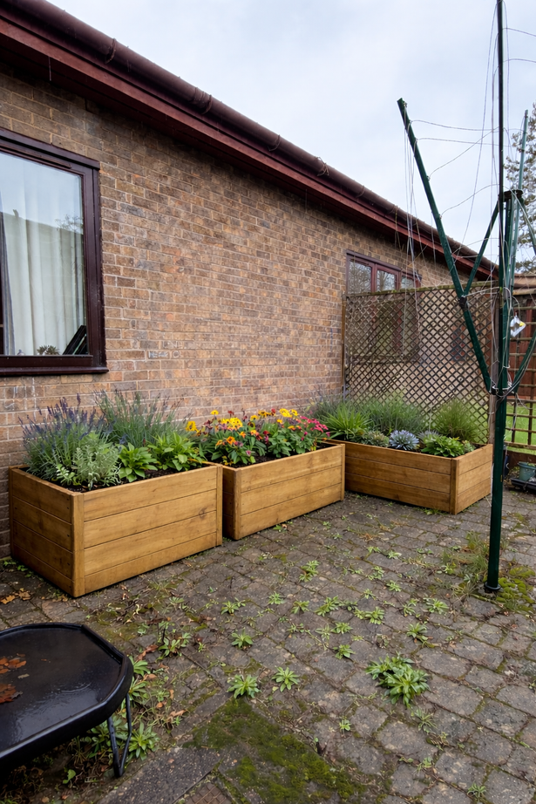
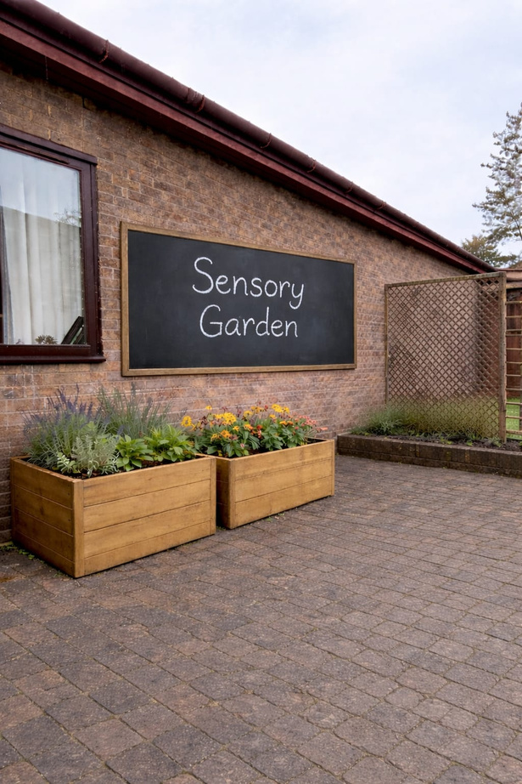
Adapting the current space
  Gardening - wellbeing, reduces stress, sensory engagement
  Chalk board - outdoor learning/useful for those that require visuals or written word etc
Notes:
Gardening is recognized for enhancing well-being by reducing stress and improving mood through nature connection, physical activity, and sensory engagement. It aids emotional regulation, routine, and achievement, especially beneficial in SEN settings. Adding an outdoor chalkboard supports visual communication and structured learning, benefiting students who thrive on visual aids and clear instructions.

Slide 10
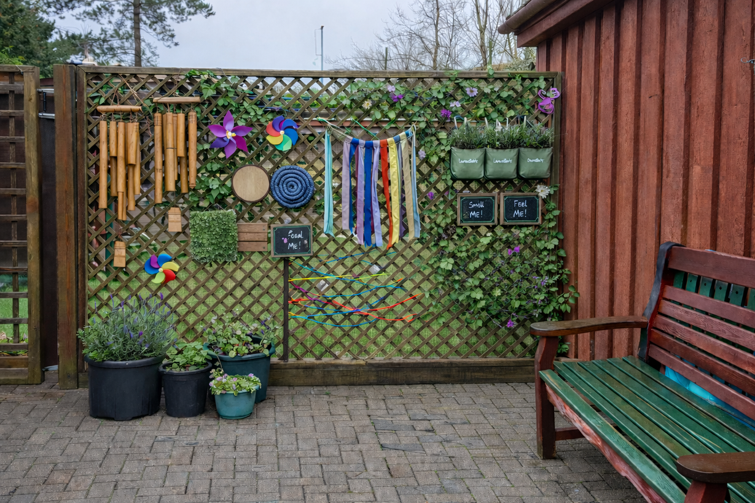
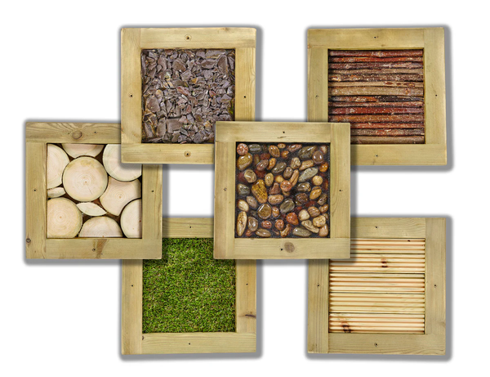
Adapting the current space
  Encouraging touch, smell and exploration
  Tactile processing and fine motor development
  Auditory input
Notes:
Incorporating texture panels, bamboo chimes, and a variety of plants that encourage touch, smell, and exploration enhances the garden’s sensory value. Different textures support tactile processing and fine motor development, while gentle auditory input from bamboo chimes can provide calming, predictable sound. Fragrant herbs and soft foliage encourage safe sensory exploration, helping students regulate, engage, and build confidence through meaningful, multi-sensory experiences tailored to individual needs.

Slide 11
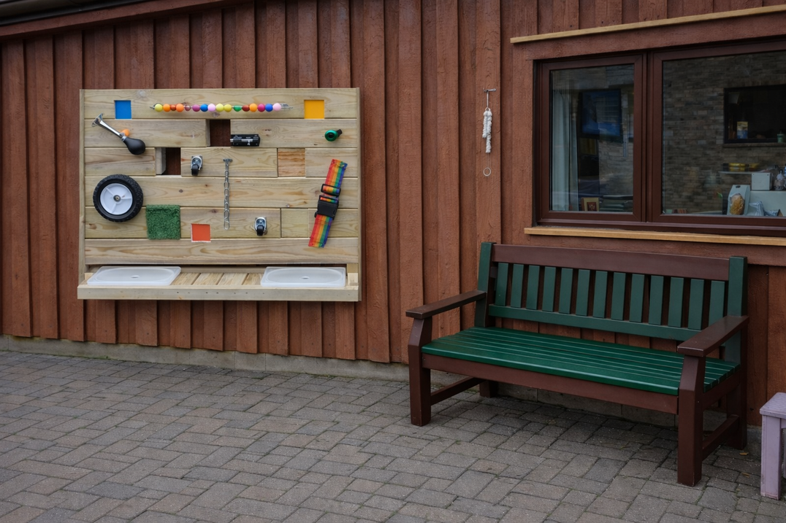
Adapting the current space
  Busy board/sensory board - hands on opportunity
  Supports fine motor development, problem solving, sensory processing
  Purposeful interaction building coordination, focus and independence
  Bench - movement breaks, group activities, accessibility, enables participation and observation
Notes:
Including a busy board or sensory board within the garden provides structured, hands-on opportunities for exploration that support fine motor development, problem solving, and sensory processing. Features such as locks, wheels, textures, and moving parts encourage purposeful interaction, helping students to build coordination, focus, and independence. It also offers a regulating activity that can support emotional control, making it easier for individuals to engage in other meaningful tasks within the garden environment.
Providing a bench within the sensory garden offers an important space for rest, regulation, and social interaction. It allows students to take movement breaks when needed and can be used for one-to-one support, group activities, or quiet observation, promoting inclusion and enabling participation at an individual pace within a safe and accessible environment.

Slide 12
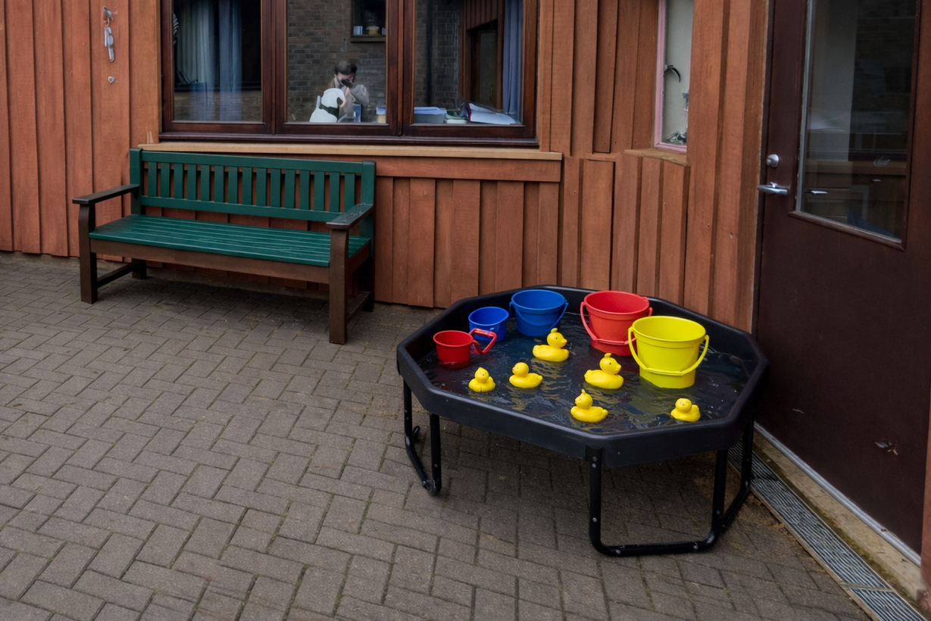


Adapting the current space
  Water play - therapeutic benefits
  Gently stimulates or calms the nervous system
  Promotes relaxation
Notes:
Including a water tray within the sensory garden is not only good for sensory benefits but also provides therapeutic benefits. It gently stimulates or calms the nervous system. The rhythmic and repetitive nature of water-based activities, such as pouring or flowing movement, can promote relaxation, reduce stress and anxiety, and support emotional regulation.

Slide 13
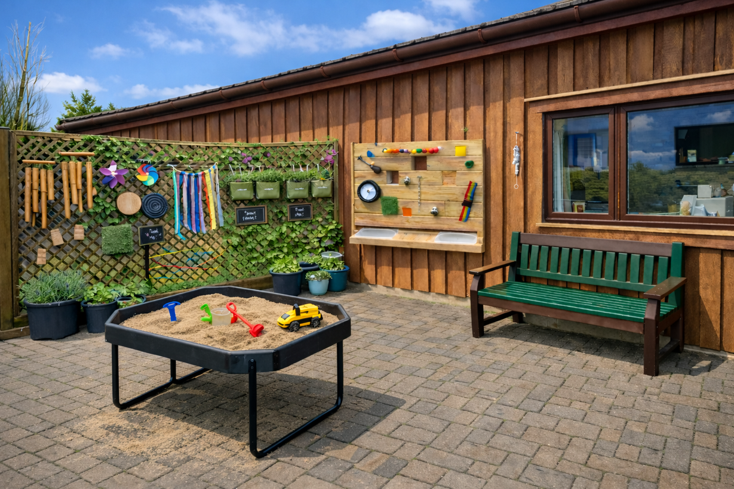

Adapting the current space
  Sand pit - sensory exploration
  Tactile processing
  Touch
  Pressure
  Movement
Notes:
Similarly to water, a sand pit provides valuable opportunities for sensory exploration, supporting tactile processing through touch, pressure, and movement.

Slide 14
Benefits for Pathways
Communication Pathway
  Provides motivating, shared activities, encouraging interaction
  Sensory play - provides stimulation
  Turn taking, communication - verbal or non verbal
  Supports eye contact, symbols, simple language to build foundational communication skills
Independence Pathway
  Self directed, purposeful activities promoting autonomy and confidence
  Encourages decision making, problem solving and sense of responsibility
  Functional activities promote everyday skills such as task initiation, routines and completing activities with increased independence.
Employability Pathway
  Develop practical, transferrable skills
  Gardening, organising, sequencing
  Builds responsibility, time management, teamwork and task completion
  Following instructions, sustaining attention.
Notes:
How can this benefit individual pathways?
A sensory garden can support the communication pathway by offering engaging activities that promote interaction and basic communication skills. Sensory play, like sand and water activities, encourages requesting, turn-taking, commenting, and joint attention through verbal and non-verbal methods. Engaging with tools and resources fosters gestures, eye contact, symbols, and simple language, aiding in the development of foundational communication skills in a meaningful, low-pressure setting.
The sensory garden can support the Independence pathway by providing opportunities for students to engage in self-directed, purposeful activities that promote autonomy and confidence. Tasks such as watering plants, using tools in the sand or water tray, choosing resources, or maintaining garden areas encourage decision-making, problem solving, and responsibility. These functional, real-life activities help develop everyday skills, allowing students to practise initiating tasks, following routines, and completing activities with increasing independence within a supportive environment.
The sensory garden can support the Employability pathway by offering opportunities to develop practical, transferable skills in a real-life context. Activities such as planting, watering, maintaining garden areas, organising tools, and following task sequences can help build responsibility, time management, teamwork, and task completion. Engaging in these purposeful roles supports work-related behaviours such as following instructions, sustaining attention, and completing routine tasks, helping to prepare students for future vocational environments.

Slide 15
References
  HUSSEIN, H. (2010). Using the sensory garden as a tool to enhance the educational development and social interaction of children with special needs. Support for Learning, 25(1), 25–31. https://doi.org/10.1111/j.1467-9604.2009.01435.x
  Soga, M., Gaston, K. J., & Yamaura, Y. (2017). Gardening is beneficial for health: A meta-analysis. Preventive Medicine Reports, 5(C), 92–99. https://doi.org/10.1016/j.pmedr.2016.11.007
  Occupational Therapy Practice Framework: Domain and Process. (2002). The American Journal of Occupational Therapy, 56(6), 609–639. https://doi.org/10.5014/ajot.56.6.609
  Goldenberg, G., Atkinson, M., Dubiel, J., & Wass, S. (2024). Outdoor learning in urban schools: Effects on 4–5 year old children’s noise and physiological stress. Journal of Environmental Psychology, 97, Article 102362. https://doi.org/10.1016/j.jenvp.2024.102362
  Ozer, E. J. (2007). The Effects of School Gardens on Students and Schools: Conceptualization and Considerations for Maximizing Healthy Development. Health Education & Behavior, 34(6), 846–863. https://doi.org/10.1177/1090198106289002
  Royal College of Occupational Therapists (RCOT). (2021). Professional Standards for practice, Conduct and Ethics. The Royal College of Occupational Therapists. https://www.rcot.co.uk/explore-resources/standards-guidelines/professional-standards-conduct-ethics

